Slide 1
Cornerstone City Church Peninsula Plus Community Hoo Are Ya 02-07-2023

Slide 2
God Loves Me
CCLI Song # 3934735
Peter Bignall | Peter Tye | Steve Whitehouse
© 2001 Thankyou Music (Admin. by Integrity Music Ltd)
For use solely with the SongSelect® Terms of Use. All rights reserved. www.ccli.com
CCLI Licence No. 33265

Slide 3
1/2
God loves me I'm gonna shout it out
God loves me I wanna live it out
God loves me I know He loves me forever

Slide 4
2/2
When I'm in the sun having fun
Then I know that He loves me
When I feel the rain I feel the same
'Cause He's the King

Slide 5
Praise You Anywhere
CCLI Song # 7219772
Ben Fielding | Brandon Lake | Hank Bentley | Jacob Sooter
Brandon Lake Music; Capitol CMG Paragon; Songs By That Dog Will Hunt; Just When Publishing; So Essential Tunes; SHOUT MP Brio
For use solely with the SongSelect® Terms of Use. All rights reserved. www.ccli.com
CCLI License # 33265

Slide 6
1/6
Sometimes you’ve gotta dance through the darkness
Sing through the fire
Praise when it don’t make sense
Sometimes you’ve gotta stare down the giant
Worship from the lion’s den

Slide 7
2/6
Sometimes you’ve gotta shout it from the mountain
Louder in the valley
Trusting that He’s gonna get you there
Sometimes you’ve gotta welcome the wonder
Wait for the answer
Worship with your hands in the air I’ll praise You anywhere

Slide 8
3/6
Praise, Give Him praise, Give Him praise
In the highest
Praise, Give Him praise, Give Him praise
In the highest
He is worthy
Yes, He is worthy of all of the praise

Slide 9
4/6
Sometimes you’ve gotta praise in the prison
Cry out to heaven
Shout it ‘til the doors swing wide
Sometimes you’ve gotta stand on your shackles
Brave in the battle
Worship with your hands held high
I’ll praise You anywhere

Slide 10
5/6
Faithful all my life
Blessings day and night
Countless reasons why
I’ll praise You anywhere
Every promise kept
Goodness every step
Each and every breath
I’ll praise You anywhere

Slide 11
6/6
Oh, I'll praise You anywhere
Oh, the mountain, the valley
I know that You're with me there
I'll praise You anywhere Praise God from whom all blessings flow
Praise Him all creatures here below
Praise Him above ye heavenly hosts
Praise Father, Son and Holy Ghost

Slide 12


Slide 13
House Of The Lord
CCLI Song # 7168995
© 2020 Phil Wickham MusicSimply Global SongsBe Essential SongsCashagamble Jet Music
For use solely with the SongSelect® Terms of Use. All rights reserved. www.ccli.com
Note: Reproduction of this sheet music requires a CCLI Music Reproduction Licence. Please report all copies.
CCLI Licence No. 33265

Slide 14
1/5
We worship the God who was
We worship the God who is
We worship the God who evermore will be
He opened the prison doors
He parted the raging sea
My God He holds the victory yeah

Slide 15
2/5
There’s joy in the house of the Lord
There’s joy in the house of the Lord today
And we won’t be quiet
We shout out Your praise

Slide 16
3/5
There’s joy in the house of the Lord
Our God is surely in this place
And we won’t be quiet
We shout out Your praise

Slide 17
4/5
We sing to the God who heals
We sing to the God who saves
We sing to the God who always makes a way
'Cause He hung up on that cross
Then He rose up from that grave
My God’s still rolling stones away

Slide 18
5/5
We were the beggars
Now we’re royalty
We were the prisoners
Now we’re running free
We are forgiven accepted
Redeemed by His grace
Let the house of the Lord sing praise

Slide 20
How Deep The Father's Love For Us
CCLI Song # 1558110
Stuart Townend
© 1995 Thankyou Music
For use solely with the SongSelect® Terms of Use. All rights reserved. www.ccli.com
CCLI License # 33265

Slide 21
1/3
How deep the Father's love for us
How vast beyond all measure
That He should give His only Son
To make a wretch His treasure
How great the pain of searing loss
The Father turns His face away
As wounds which mar the Chosen One
Bring many sons to glory

Slide 22
2/3
Behold the Man upon a cross
My sin upon His shoulders
Ashamed I hear my mocking voice
Call out among the scoffers
It was my sin that held Him there
Until it was accomplished
His dying breath has brought me life
I know that it is finished

Slide 23
3/3
I will not boast in anything
No gifts no pow’r no wisdom
But I will boast in Jesus Christ
His death and resurrection
Why should I gain from His reward
I cannot give an answer
But this I know with all my heart
His wounds have paid my ransom

Slide 25


Slide 26
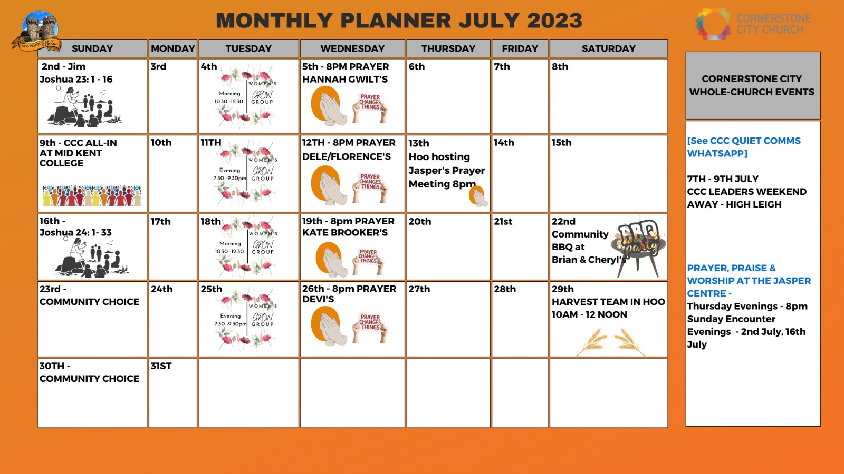

Slide 27


Slide 28
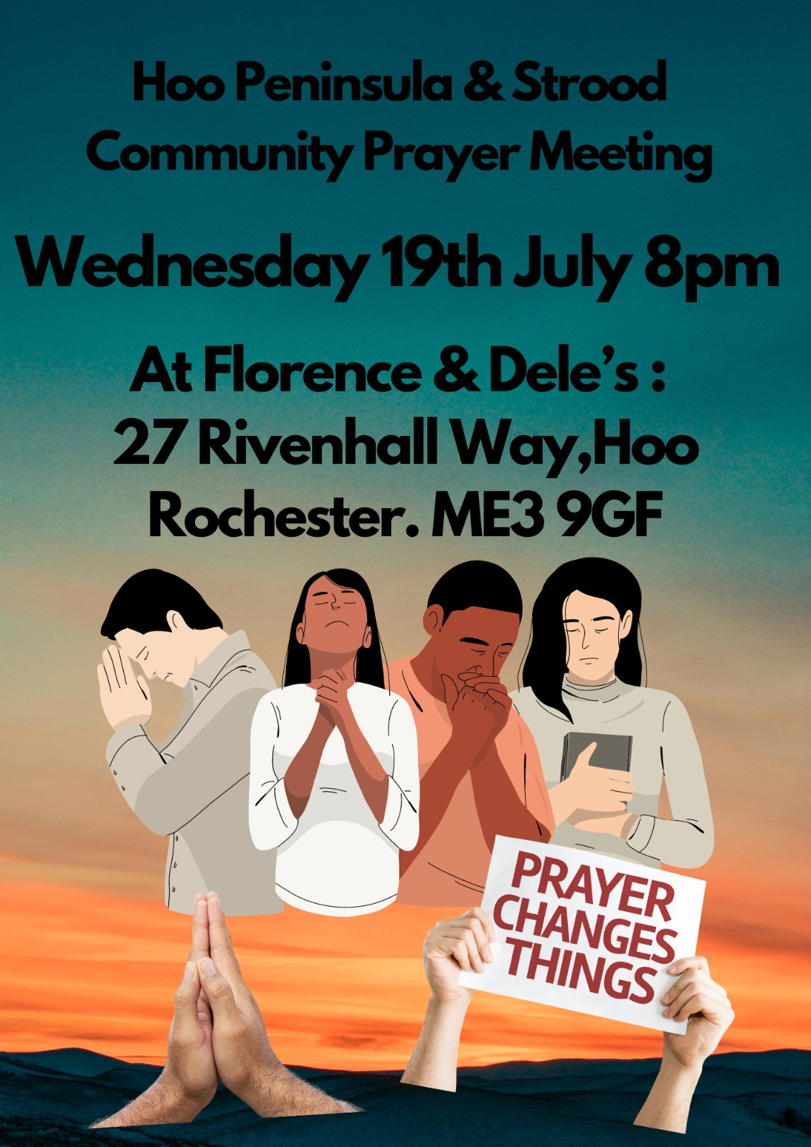

Slide 29


Slide 30


